Slide 1
Checking by estimating
Estimation and rounding

Slide 2
how to use Oak lessons

Slide 3
I can estimate and check if solutions to problems are of the correct magnitude.

Slide 4
Significant figures are the digits in a number that contribute to the accuracy of the number.
The first significant figure is the first non-zero digit.
Number lines can be used to round to one significant figure.
Example
6523 = 7000 (1 s.f.)
6523 = 6500 (2 s.f.)
6523 = 6520 (3 s.f.)

Slide 5
A quick estimate for a calculation is obtained from using approximate values, often rounded to 1 significant figure.
When showing estimations we use to identify that the calculations are approximately the same but not equal.
For example,

Slide 6

Checking by estimating
Estimating answers
Checking answers

Slide 7
Estimating answers
A quick estimate for a calculation is obtained from using approximate values, often rounded to 1 significant figure.
In everyday life, it is important to estimate so to know how to quickly calculate a rough answer or to check the accuracy of answers.

Slide 8

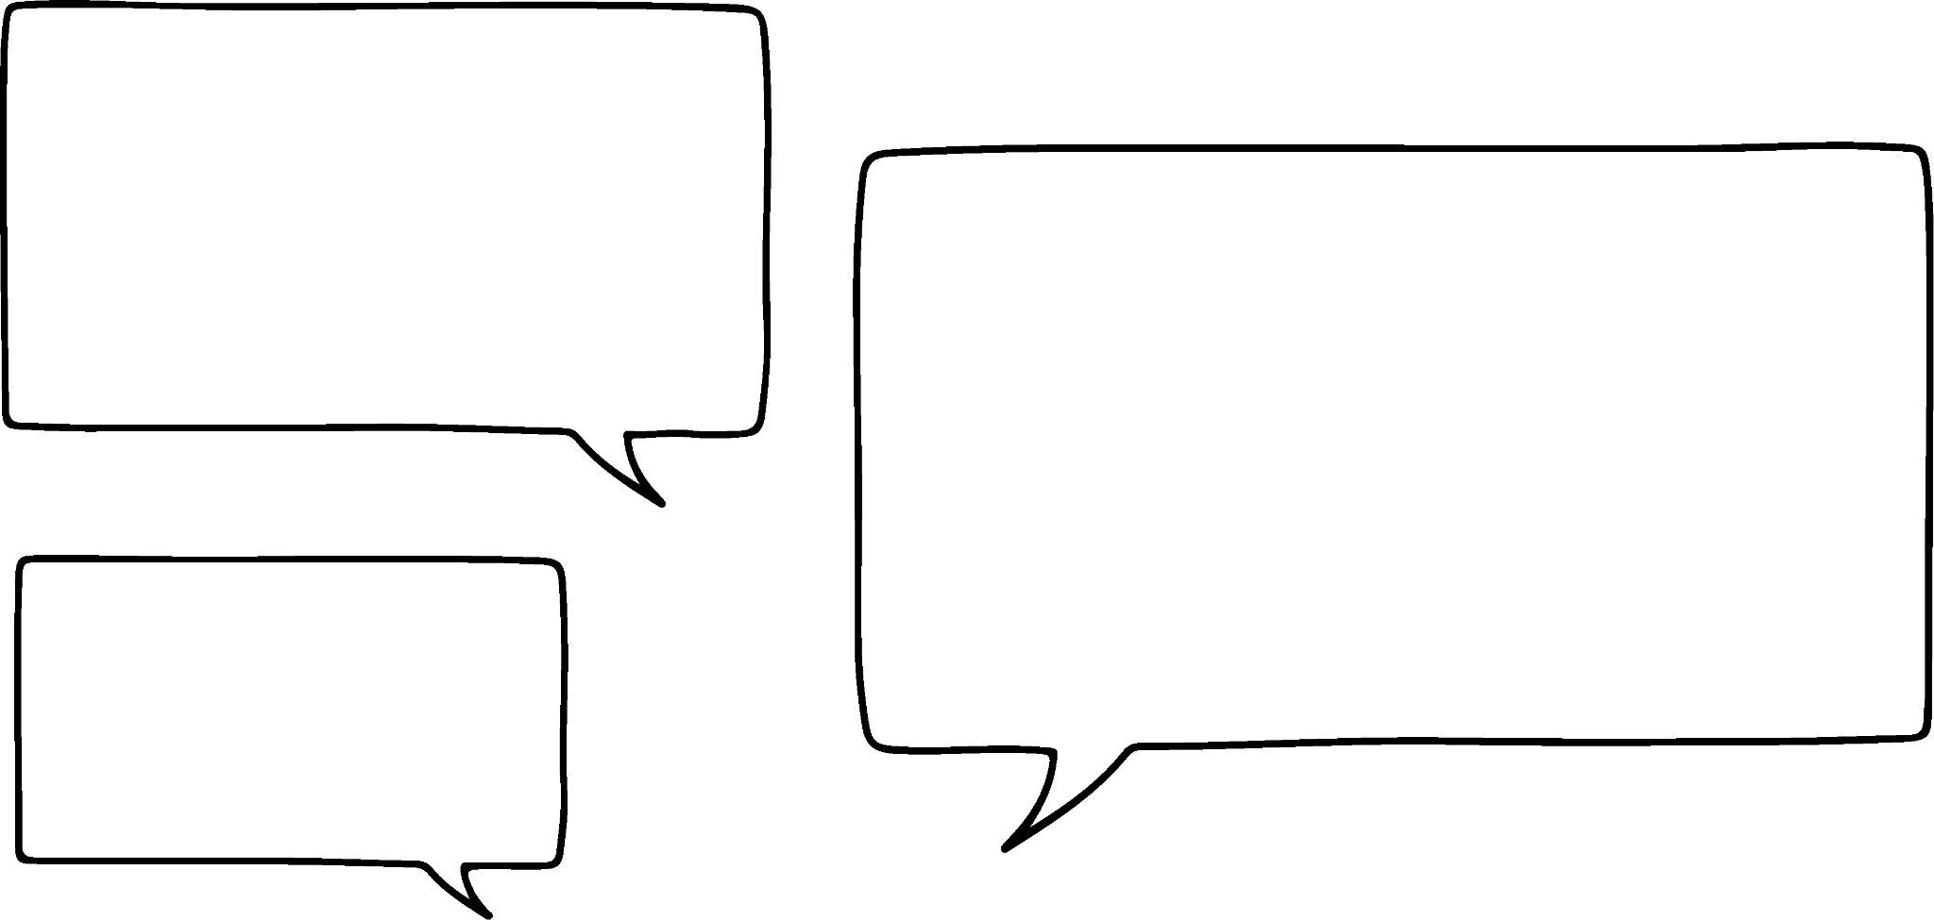
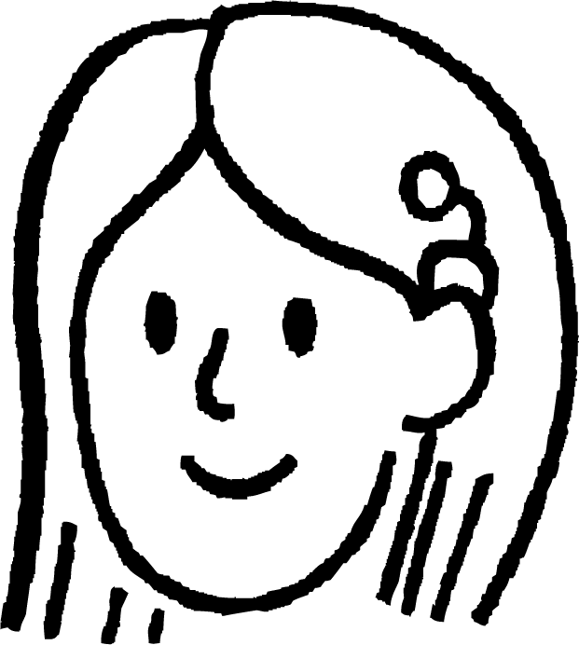
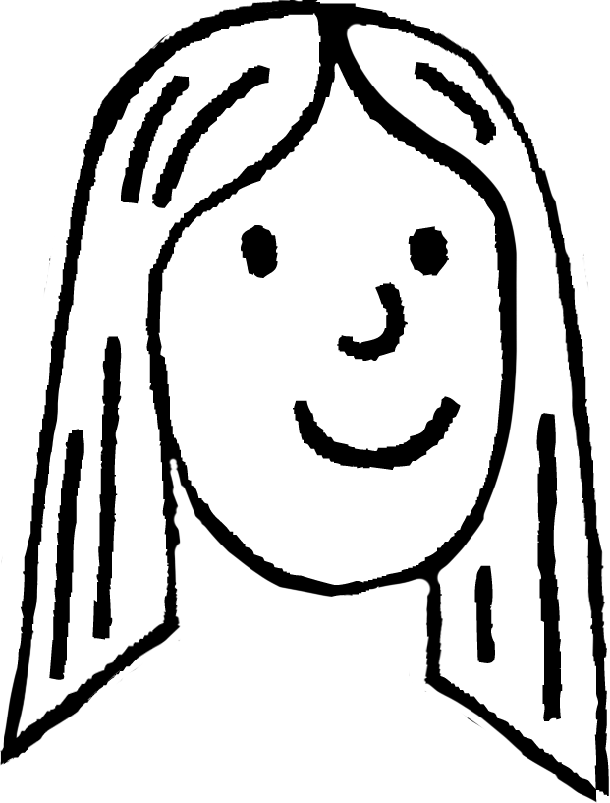
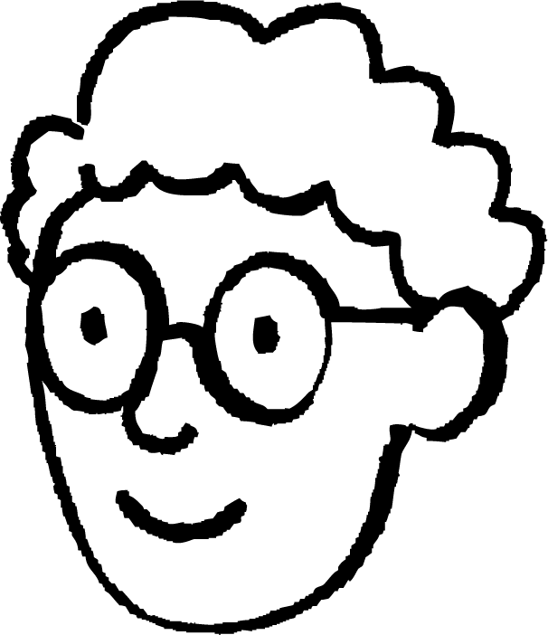
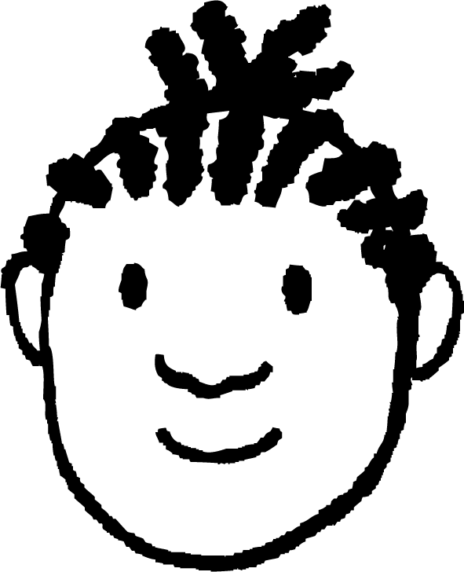

Estimating answers
For example, here is a calculation and pupil responses.
Who do you agree with and why?
The answer is 3000 because 300 × 10
The answer is 2700. It is maths so there is only 1 answer.
The answer is 2500 because 250 × 10
Sofia
You are all right except Alex’s explanation
Alex
Laura
Jacob

Slide 9
Estimating answers
As estimation gives an approximate answer, there is more than one estimate.
The answer is 2700
Alex rounded 272.56 to 2 s.f. and 9.769 to 1 s.f.
Alex

Slide 10
Estimating answers
As estimation gives an approximate answer, there is more than one estimate.
The answer is 2500 because 250 × 10
Jacob rounded 272.56 to the nearest 50 and 9.769 to 1 s.f.
Jacob

Slide 11
Estimating answers
As estimation gives an approximate answer, there is more than one estimate.
The answer is 3000 because 300 × 10
Sofia
Sofia rounded 272.56 to 1 s.f. and 9.769 to 1 s.f.

Slide 12
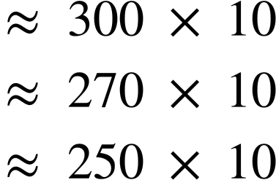
Estimating answers
As estimation gives an approximate answer, there is more than one estimate.
You are all right.
Estimation gives a rough answer. The more significant figures we round to, the more accurate the estimation.
Laura

Slide 13
Estimating answers
Knowing how to round so to estimate and knowing which sensible units to use is as equally important as knowing which operation to apply given the context of the question.
For example, which operation do we tend to use when calculating:
Area of a 2D shape
Perimeter
Difference between values
How many times a number fits into another number?
Multiplication
Addition
Subtraction
Division

Slide 14
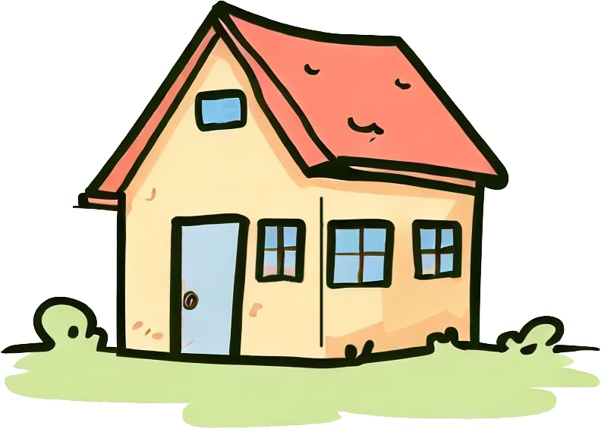
Estimating answers
Which of the following is a sensible measurement for the lengths of an average house?
Front : 844 mm
Side : 596 mm
Front : 0.844 km
Side : 0.896 km
Front : 844 cm
Side : 596 cm
Front : 8.44 m
Side : 5.96 m
Front
Side
Using this, can you calculate an estimate for the area of the floor of the house?
Area of floor 800 × 600
Area of floor 8 × 6
480 000 cm²
48 m²

Slide 15
Estimating answers
A book shop needs to buy the latest Maths Puzzle books. Each book costs £6.89. The book shop only has £279.45 to spend on these puzzle books. Estimate how many books the book shop can buy. Make sure to show your working out.
You may have chosen,
You may have chosen,
279.45 ÷ 6.89
280 ÷ 7
279.45 ÷ 6.89
300 ÷ 10
40 books
30 books
Estimation gives a rough answer. The more significant figures we round to, the more accurate the estimation.

Slide 16
Estimating answers
Receipt
Lucas bought some items in a shop and paid with a £10 note. The receipt was damaged and the total is not seen. He receives £2.12 change.
He quickly knew there is an error.
How did he know there was an error without calculating the exact change?
Items
Price
Pen £2.12
Pencil £0.78
Ruler £1.89
Crisps £1.12
The first two items are around £3 in total. The next two items are also around £3 in total. His bill will be around £6 so he should get close to £4 in change.
Total

Slide 17
Estimating answers
A rectangle has dimensions 145 m by 18.4 m.
Which calculation would give a suitable estimate for the area of the rectangle? Explain why you think it is a suitable estimation.
a) 150 × 18
b) 150 × 20
c) 100 × 20
d) 18 × 145
145 m
18.4 m

Slide 18
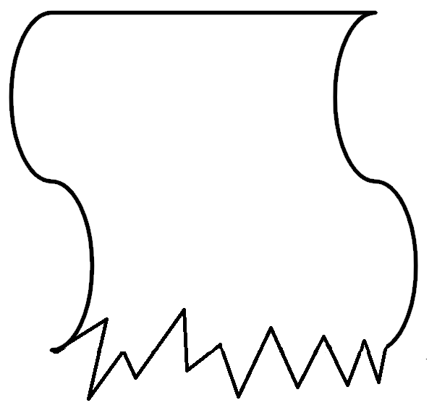
Estimating answers
2) Here are 3 damaged receipts. Each pupil pays with a £20.
Aisha gets £12.23 change. Jacob gets £6.89 change. Sam gets £9.11 change. Only using estimation, which student went to which shop?
Shop A
Shop B
Shop C
Items
Price
Items
Price
Items
Price
USB £5.03
Pencil £1.02
Calc £5.12
Stamps £7.83
Paper £0.28
Pencil £0.78
Label £2.99
Pens £0.91
Ruler £1.89
Pencil £0.56
Crisps £1.27
Paper £3.10
Crisps £0.99
To tal
To tal
To tal

Slide 19
Estimating answers
3) Another receipt was damaged. Jun remembers paying with a £50 note and receiving about £3 back in change. Estimate how much the board game was. You must show your working out.
Items
Price
Stamps £5.31
Calc £8.12
Pencil £0.94
Ruler £1.89
Paper £4.50
USB £8.59
B. Game £
To tal

Slide 20
Estimating answers
A rectangle has dimensions 145 m by 18.4 m.
Which calculation would give a suitable estimate for the area of the rectangle? Explain why you think it is a suitable estimation.
a) 150 × 18
b) 150 × 20
c) 100 × 20
d) 18 × 145
145 m
18.4 m
This is suitable because each number has been rounded to 2 s.f.
This is suitable because each number has been rounded to the nearest 10
This is suitable because each number has been rounded to 1 s.f.
This is suitable because each number has been rounded to the nearest integer.

Slide 21
Estimating answers
2) Here are 3 damaged receipts. Each pupil pays with a £20.
Aisha gets £12.23 change. Jacob gets £6.89 change. Sam gets £9.11 change. Only using estimation, which student went to which shop?
Shop A
Estimating
£5 + £1 + £2 + £3 = £11
Approximate change expected £9.
Sam went to Shop A
Items
Price
Calc £5.12
Pencil £0.78
Ruler £1.89
Paper £3.10
To tal

Slide 22
Estimating answers
2) Here are 3 damaged receipts. Each pupil pays with a £20.
Aisha gets £12.23 change. Jacob gets £6.89 change. Sam gets £9.11 change. Only using estimation, which student went to which shop?
Shop B
Estimating
£1 + £8 + £3 + £1 = £13
Approximate change expected £7.
Jacob went to Shop B
Items
Price
Pencil £1.02
Stamps £7.83
Label £2.99
Crisps £1.27
To tal

Slide 23
Estimating answers
2) Here are 3 damaged receipts. Each pupil pays with a £20.
Aisha gets £12.23 change. Jacob gets £6.89 change. Sam gets £9.11 change. Only using estimation, which student went to which shop?
Shop C
Items
Price
Estimating
£5 + £0.30 + £1 + £0.50 + £1 = £7.80
Approximate change expected £12.20.
Aisha went to Shop C
USB £5.03
Paper £0.28
Pens £0.91
Pencil £0.56
Crisps £0.99
To tal

Slide 24
Estimating answers
3) Another receipt was damaged. Jun remembers paying with a £50 note and receiving about £3 back in change. Estimate how much the board game was. You must show your working out.
Items
Price
Stamps £5.31
Estimating
£5 + £8 + £1 + £2 + £5 + £9 = £30
Given the change from £50 was £3
£50 - £33 = £17
The board game was approximately £17
Calc £8.12
Pencil £0.94
Ruler £1.89
Paper £4.50
USB £8.59
B. Game £
To tal

Slide 25
Checking by estimating
Estimating answers
Checking answers

Slide 26
Checking answers
Sometimes we are given answers to calculations and the answer just doesn’t seem correct.
For example, three pupils give an estimate to a calculation.
Immediately, the Oak teacher knows who is correct. Who is correct and how can it be seen so quickly?

Slide 27
Checking answers
It cannot be 150 as this is more than 121. Any number multiplied by a number less than 1 will give a smaller value.
is slightly more than a half, so we expect the answer to be slightly more than a half of 121.
is slightly more than a half, so we expect the answer to be slightly more than 60.

Slide 28

Checking answers
Andeep has given this diagram to his friends. Below are their responses. Who do you agree with and why?
1.9cm
2.89cm
5.7cm
Impossible! I don’t even need my ruler to know it is wrong.
Looks good! I will check with my ruler to see if it is right.
a
b
Alex
Laura

Slide 29
Checking answers
Andeep has given this diagram to his friends. Below are their responses. Who do you agree with and why?
1.9cm
2.89cm
5.7cm
The sum of the other two lengths must be longer than the third length for them to connect. Laura has estimated 2 + 3 < 6 so knows it is impossible.
Impossible! I don’t even need my ruler to know it is wrong.
b

Slide 30
Checking answers
We can use our common sense when looking at calculations and their answers, but we can also use estimation to check the answer as well as identify how the error has come about.

Slide 31
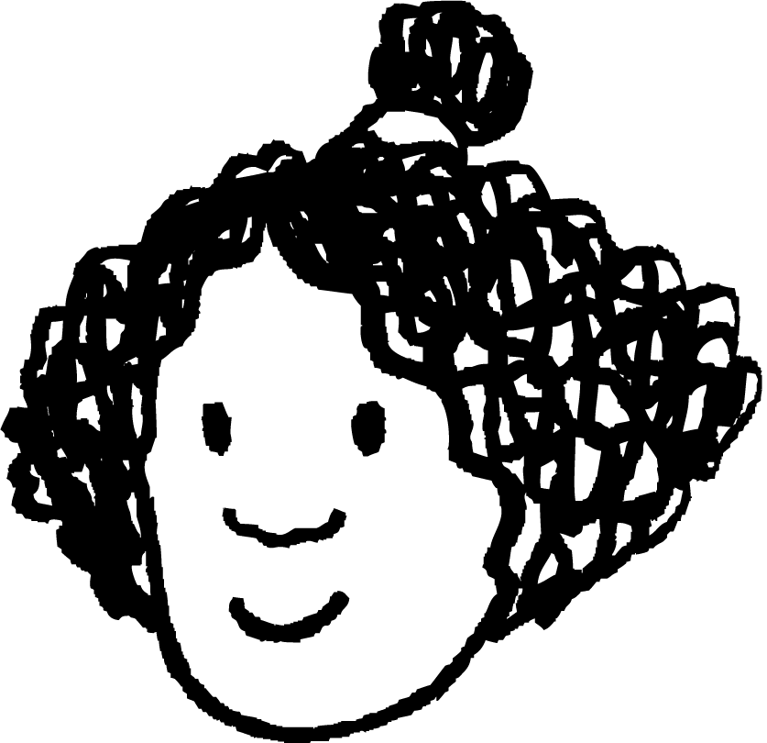

Checking answers
A book shop needs to buy the second publication of Maths Puzzle books. Each book costs £4.82. The book shop only has £371.02 to spend on these puzzle books. Three Oak pupils worked out an estimate number of books.
Who is correct and what mistake(s) did the other pupil(s) make?
80 books
400 ÷ 5 = 80
Izzy
Jun
2000 books
400 × 5
74 books
370 ÷ 5 = 74
Izzy and Alex are correct.
Alex

Slide 32
Checking answers
When reflecting on an answer, it is important to ask yourself
“Is the answer realistic?”
2000 books is a lot of books for the amount of money the book shop has.
Jun
2000 books

Slide 33
Checking answers
Using estimation only, put a tick with the calculation which gives the approximate correct answer. Where the answer is incorrect, identify the error.
Buying 34 books each costing £21.32 £700
A rectangle with lengths 3.21 cm by 9.56 cm has an area 30 cm²
A square with length 8.23 mm has a perimeter 64 mm
There are approximately forty five 50p pieces in £91.

Slide 34
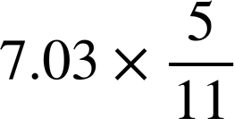
Checking answers
2)
Is approximately:
Make sure to show your reasoning or working out.
6
14
3
4
Not possible to estimate

Slide 35
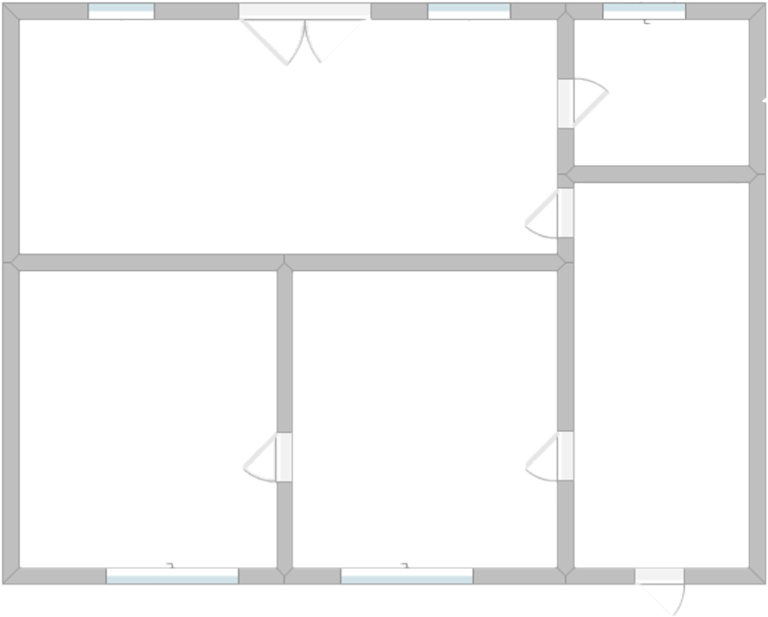
Checking answers
3) Here is a floor plan of a one bedroom apartment. The Oak teacher spots an error with a measurement given.
Can you find the error? Estimate what the correct measurement should be.
Can you estimate the area of the missing room?
3.77 m²
18.47 m²
7.03 m
11.18 m²
11.49 m²
92.4 m

Slide 36
Checking answers
Using estimation only, put a tick with the calculation which gives the approximate correct answer. Where the answer is incorrect, identify the error.
Buying 34 books each costing £21.32 £700
A rectangle with lengths 3.21 cm by 9.56 cm has an area 30 cm²
35 × 20 = 700
Area = 3 × 10 = 30
A square with length 8.23 mm has a perimeter 64 mm
There are approximately forty five 50p pieces in £91.
Area = 8 × 8 = 64
Perimeter = 8 + 8 + 8 + 8 = 32
45 × 0.5 = 45 ÷ 2 = 22.5
Or 90 ÷ 0.5 = 90 × 2 = 180

Slide 37
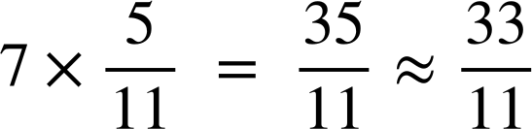
Checking answers
2)
Is approximately:
Make sure to show your reasoning or working out.
6
14
3
3
4
Not possible to estimate
There are a few ways to determine this approximation.
Example, is slightly below a half so a little below half of 7 is 3.
Example is rounding giving an approximate answer of 3.

Slide 38
Checking answers
3) Here is a floor plan of a one bedroom apartment. The Oak teacher spots an error with a measurement given.
Can you find the error? Estimate what the correct measurement should be.
3.77 m²
18.47 m²
7.03 m
11.18 m²
11.49 m²
Far too big given the areas stated.
92.4 m

Slide 39
Checking answers
3) Here is a floor plan of a one bedroom apartment. The Oak teacher spots an error with a measurement given.
Can you find the error? Estimate what the correct measurement should be.
3.77 m²
18.47 m²
7.03 m
11.18 m²
11.49 m²
9 m
Accept anything between 8 m and 12 m inclusive.
9 m

Slide 40
Checking answers
3) Here is a floor plan of a one bedroom apartment. The Oak teacher spots an error with a measurement given.
b) Can you estimate the area of the missing room?
3.77 m²
18.47 m²
7.03 m
17 m²
11.18 m²
11.49 m²
Estimating the length to be 9 m, the total area is expected to be
7 × 9 = 63
Therefore, rounding and subtracting the other areas
63 - 20 - 4 - 11 - 11 = 17
9 m

Slide 41
Checking answers
3) Here is a floor plan of a one bedroom apartment. The Oak teacher spots an error with a measurement given.
b) Can you estimate the area of the missing room?
3.77 m²
18.47 m²
7.03 m
17 m²
11.18 m²
11.49 m²
Accept anything between 15 m² and 20 m² inclusive.
9 m

Slide 42
Checking by estimating
In everyday life, it is important to estimate so to know how to quickly calculate a rough answer or to check the accuracy of answers.
Estimation is important because sometimes we are given answers to calculations and the answer just doesn’t seem correct.
When reflecting on an answer, it is important to ask yourself, “Is the answer realistic?” and if not, it helps to identify where an error has occurred.

Slide 43

© Oak National Academy 2024.
Produced in partnership with Mathematics in Education and Industry.
Licensed on the Open Government Licence v3.0, except where otherwise stated. See Oak terms and conditions.

